Slide 1
Davis Jenkins, Senior Research Scholar
Reimagining Program Onboarding
To Achieve More Equitable Student Outcomes
(and Build Back Enrollment)
Florida Pathways Institute, October 19, 2021

Slide 2
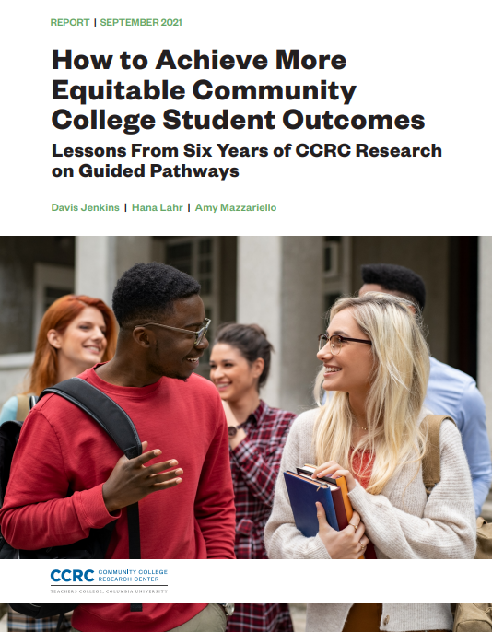
Based on 6 years of research, our thinking on guided pathways has evolved.
Source: https://ccrc.tc.columbia.edu/publications/equitable-community-college-student-outcomes-guided-pathways.html
Notes:
Students come to community colleges with goals in mind. But most students never complete a degree or credential, and in fact, about half of students leave by the start of their second year. This workshop makes the case for reimagining students’ first year to ensure they know where their programs lead and what opportunities exist for future education and employment, and that they are helped to enter a program of study in their first year.
This workshop presents a framework to facilitate equitable program onboarding (ACIP) by
Asking students about their interests and aspirations,
Connecting students with faculty and peers who share their interests,
Inspiring students to learn,
and helping students develop an individualized education Plan.

Slide 3
Why focus on program onboarding?

Slide 4
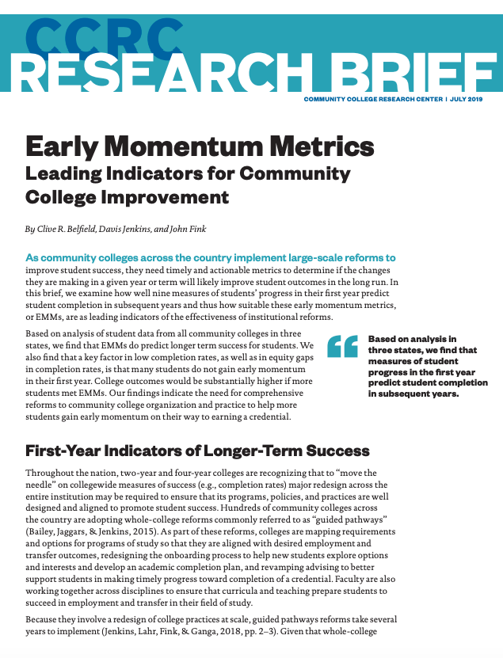





Early Academic Momentum
Students who gain early momentum are more likely to complete.
Persistence and Course Completion
Gateway Course Momentum
Fall-Spring Persistence
Completed college math/English in year 1
Course completion rate in year 1
Credit Momentum
Longer-Term Outcomes
Completed 24+ college credits in year 1
Early Program Momentum
Passing program gateway courses in year 1

Slide 5
Early momentum has added benefits for students of color and low-income students…
Benefit of completing 12+ college-level credits on transferring and completing a bachelor’s degree
Black students
2.4x
Hispanic students
4.2x
Other students
1.7x
 |  | Effects even larger for…
Transfer to a four-year institution | Benefit of milestone (baseline group: White) | Black students | Hispanic students | Low-income students
Credit momentum (6+, 12+, or 24+ college credits) | 3–5x | 3–6x | 6–11x | 7–8x
Gateway English/math (college-level) | 3–4x | 3–4x | 6–8x | 4–6x
Completed transfer degree | 7–8x | 9–11x | 11–18x | 11–13x
Transfer and bachelor’s completion
Credit momentum (6+, 12+, or 24+ college credits) | 1.7–2x | 2–3x | 4–5x | 7–9x
Gateway English/math (college-level) | 1.6–3x | 2–4x | 4–5x | 4–5x
Completed transfer degree | 3–4x | 5–6x | 5–9x | 6–7x
Source: Yuxin Lin, Maggie Fay, & John Fink (2020). CCRC analysis using statewide administrative data on 573,806 community college entrants between 2009 and 2018, tracked up to 10 years. Estimated odds ratios from hazard models controlling for student characteristics, college fixed effects, and cohort fixed effects.

Slide 6
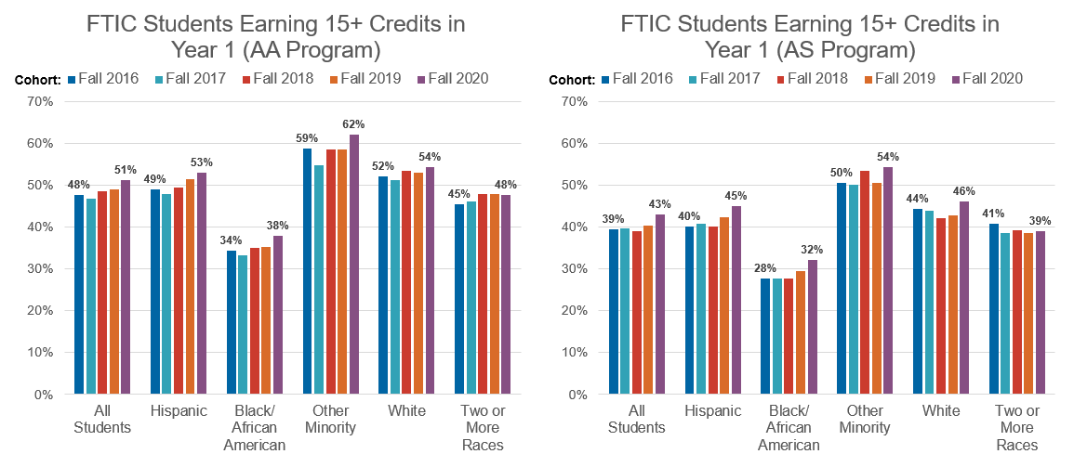
…but only about 40%-50% of FTIC FCS students gain early momentum…
Source: CCRC analysis of FCS KPI data.

Slide 7
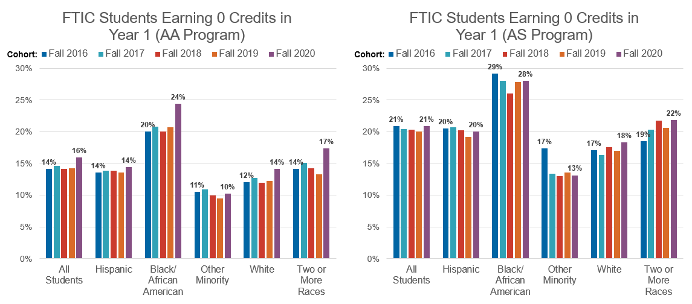
…and too many, particularly students of color, earn no college credits in their first year
Source: CCRC analysis of FCS KPI data.

Slide 8
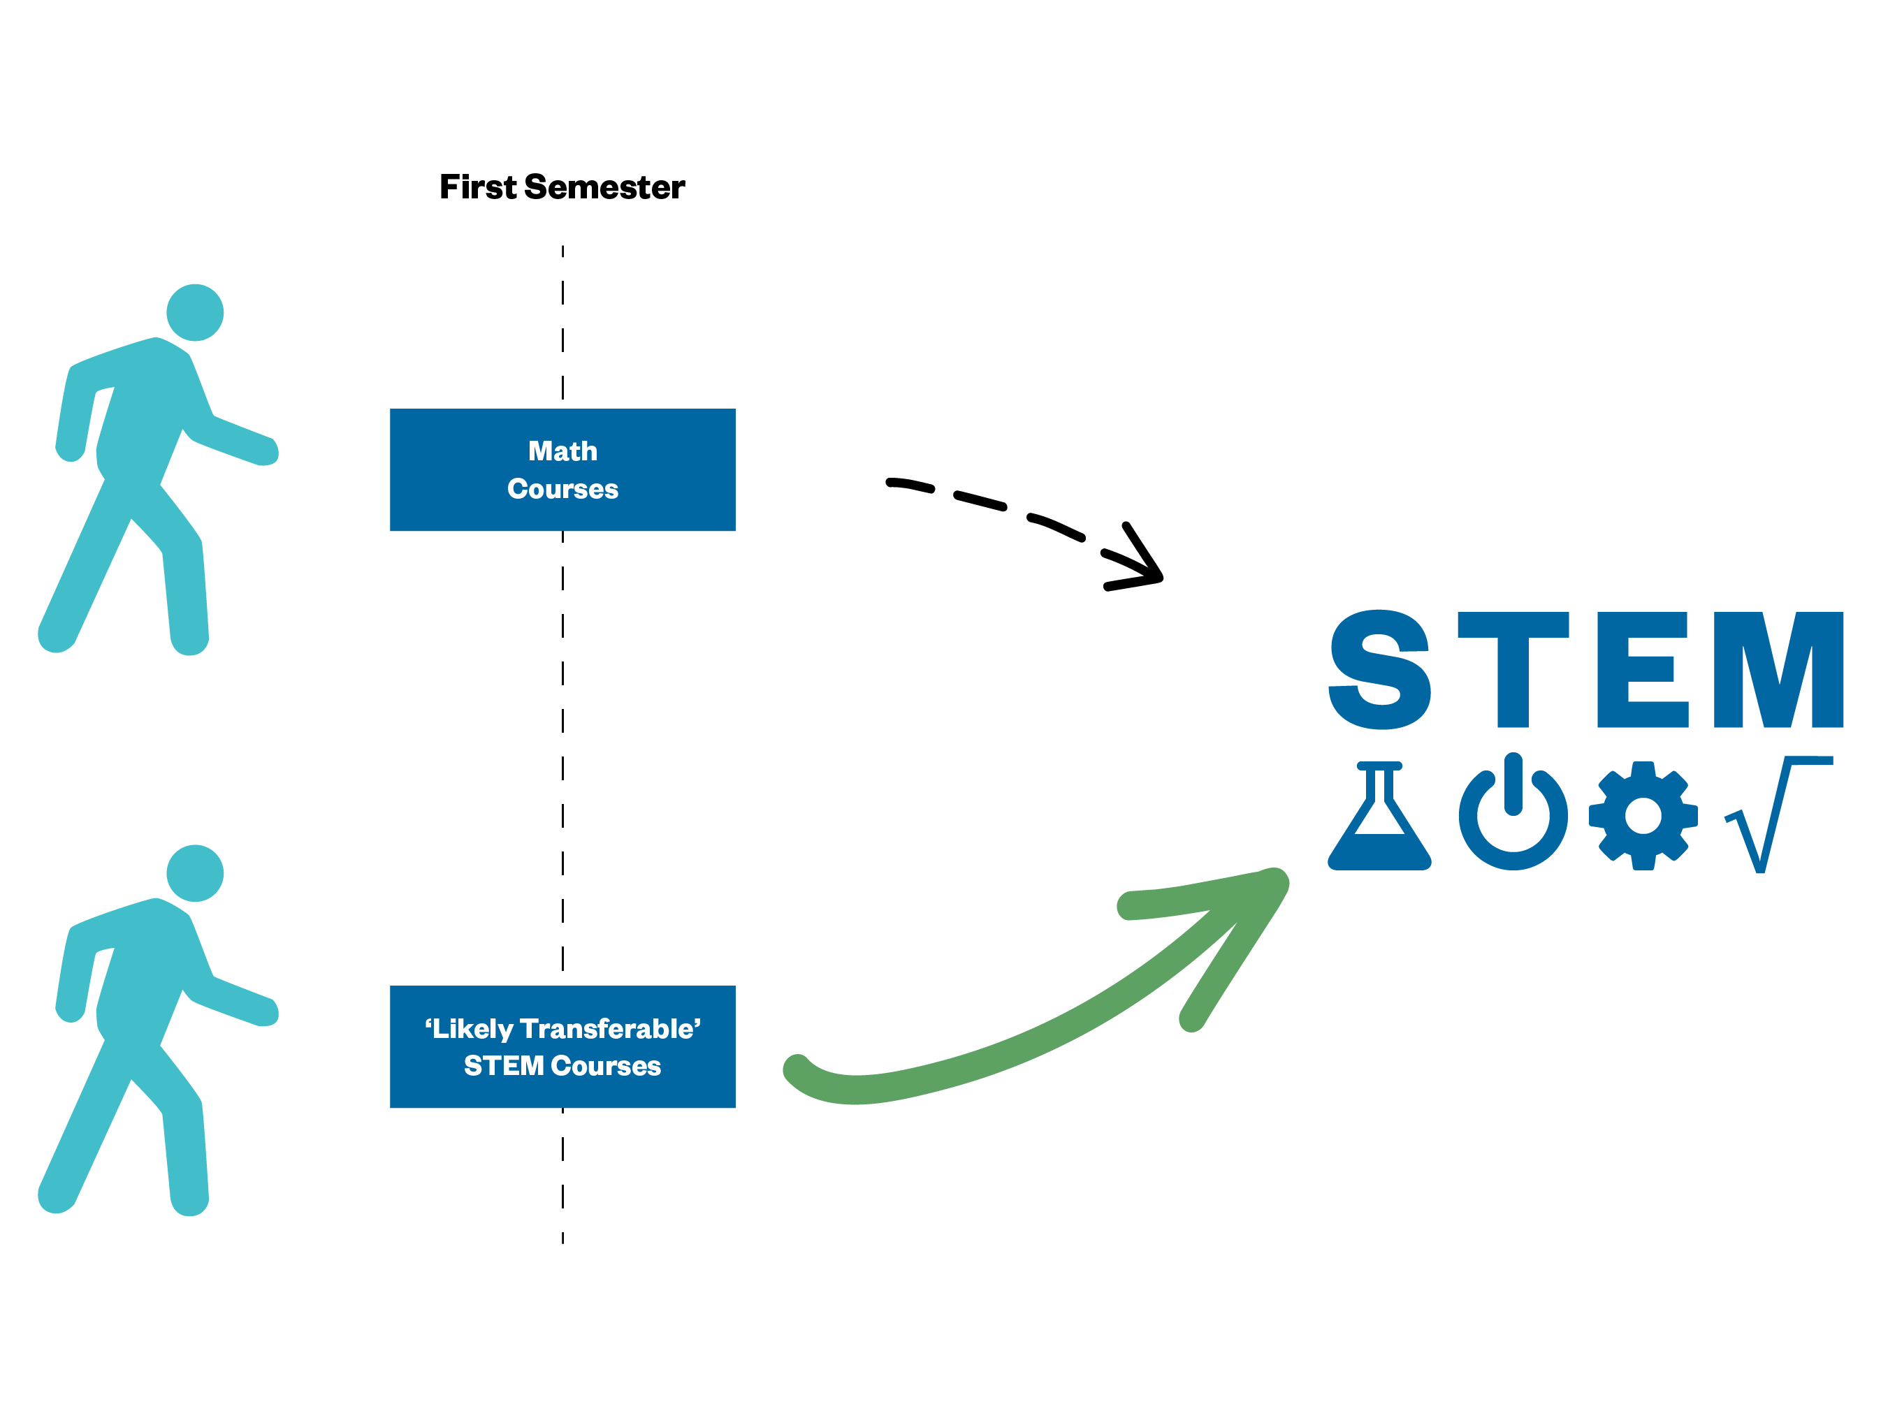
Students benefit from taking program foundation courses in their field of interest early on.
Students who successfully transferred in STEM more frequently took STEM transfer courses before transfer math courses.
Is it helpful for students to get a 'taste' of STEM to keep them interested as they work through the math courses?
Source: Wang, X. Res High Educ (2016) 57: 544. https://doi.org/10.1007/s11162-015-9397-4

Slide 9





Capturing Early STEM Transfer Program Momentum
STE Course Type (Excluding Math)
STE Transfer – State Pathways (e.g., Chem I/II; Bio I/II)
STE Foundation (Pre-Reqs to STEM Transfer, e.g., intro chem/bio courses)
Other STE, Likely Transferable
Other STE, Likely Terminal
Any STEM
Math Course Type
Calculus
Foundations to Calculus (Pre-Calculus, Trigonometry/ Geometry, College Algebra)
Statistics
Other Math Subjects (College Level)
Developmental Math
Fink, J., Myers, T., Sparks, D., & Jaggars, S. (2021). Toward a Practical Set of STEM Transfer Program Momentum Metrics (CCRC Working Paper No. 127). Columbia University, Teachers College, Community College Research Center.

Slide 10
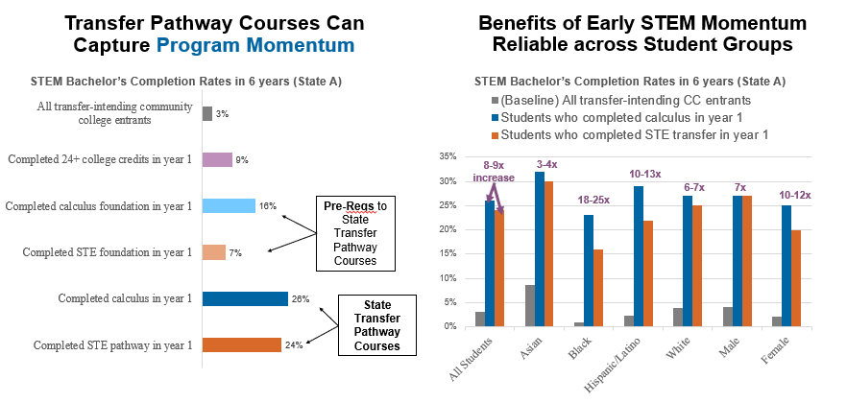
John Fink, Taylor Myers, Daniel Sparks, & Shanna Jaggars, Forthcoming September 2021. Toward a Practical Set of STEM Transfer Program Momentum Metrics. CCRC Working Paper.

Slide 11
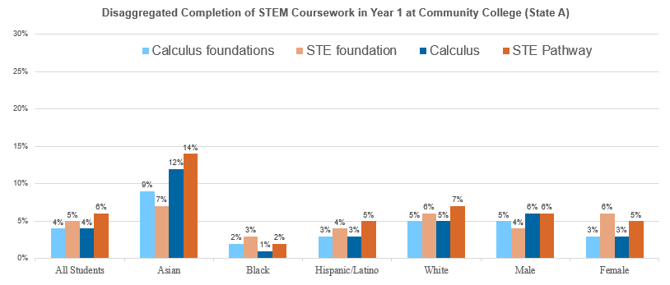
Few Students Gain STEM Momentum, Equity Gaps Present Early
John Fink, Taylor Myers, Daniel Sparks, & Shanna Jaggars, Forthcoming September 2021. Toward a Practical Set of STEM Transfer Program Momentum Metrics. CCRC Working Paper.

Slide 12
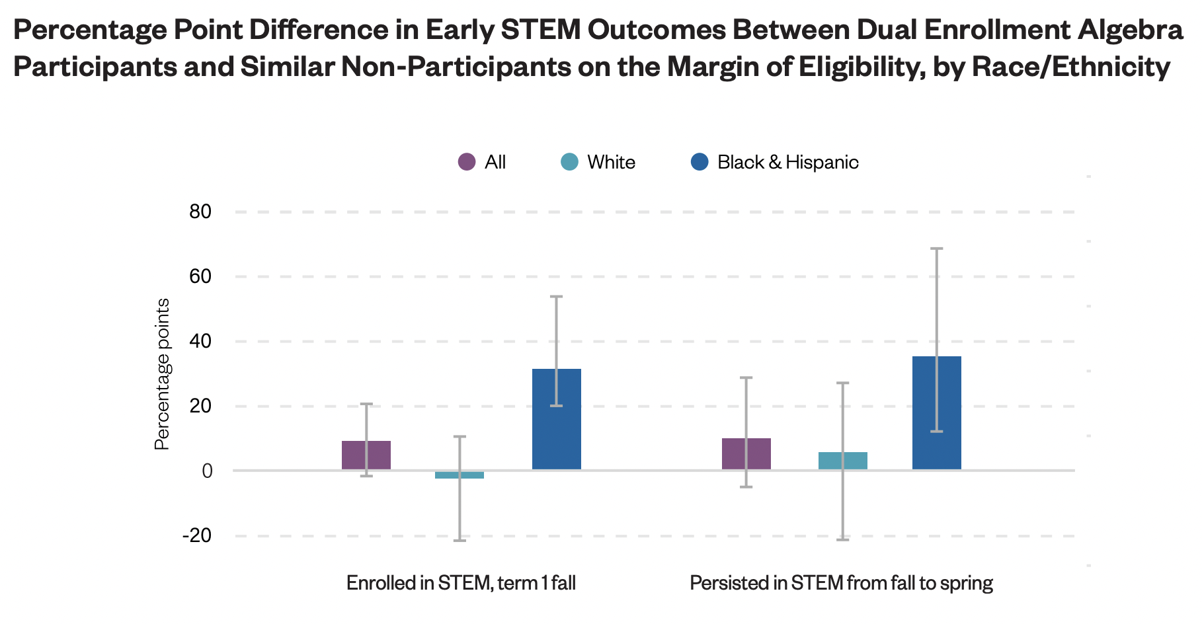
Dual Enrollment Can Help STEM-Intending Black & Hispanic Students Avoid the Math Sorting System
Minaya, V. (2021). Can dual enrollment algebra reduce racial/ethnic gaps in early stem outcomes? Evidence from Florida. Columbia University, Teachers College, Community College Research Center. https://ccrc.tc.columbia.edu/publications/dual-enrollment-algebra-stem-outcomes.html

Slide 13


Is it clear to students where their programs lead?
Category | Description | Examples | Clear to students what this program leads to?
Workforce: Low | Program places students into jobs with low average earnings (e.g., less than $14/hour) | Criminal Justice, Automobile Technology, Early Childhood
Workforce: Medium | Program places students into relatively middle-paying job (e.g., between $14-$17.55/ hour) | Accounting, Welding, Business Management, Dental Assistant
Workforce: High | Program places students into a relatively high-paying job (e.g., more than $17.55/ hour) | Nursing, Radiology Technology, Sonography, Dental Hygiene
Transfer: Structured | Program designed to prepare students for a particular baccalaureate major/meta-major and/or a specific four-year destination | AA-Business (DTA), AS-T (Engineering)
Transfer: Unstructured | Program designed for general transfer (no pre-major or university destination necessarily specified) | AA-General Studies, “General Transfer”
Undeclared or Unknown | Listed as undeclared or missing program information | Null, Missing Program, Undeclared
Uncategorized or Other | Non-degree seeking, ESL, ABE, dual enrollment | Basic Education, ESL, Running Start
Source: Fink and Jenkins (2020). https://ccrc.tc.columbia.edu/publications/unpacking-program-enrollments-completion-equity.html

Slide 14
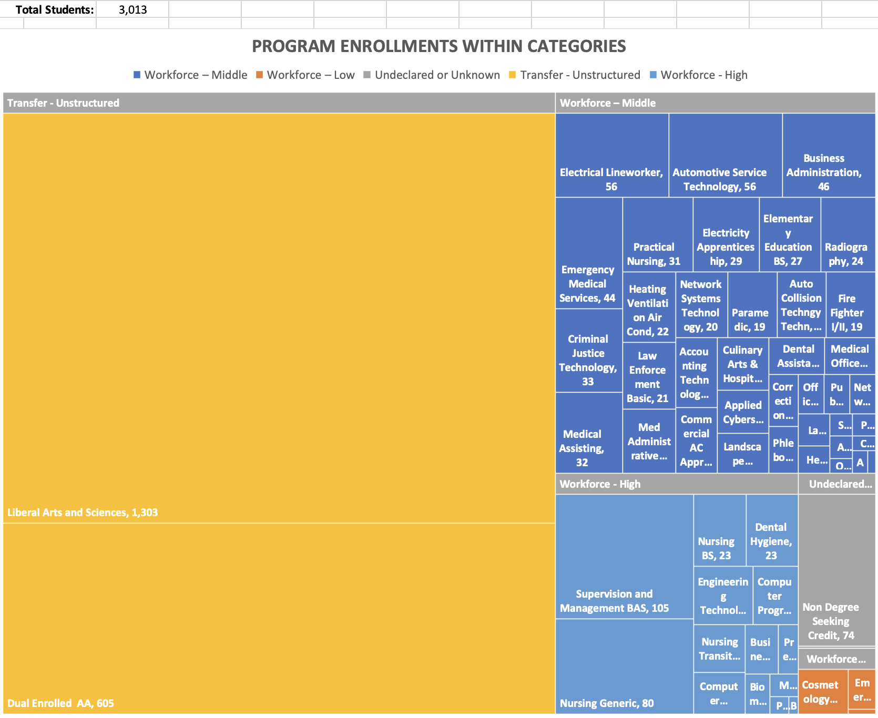
Too many community college students (including dual enrollment students) are not enrolled in a program that clearly leads to a good job or transfer in their major field of interest.
What motivation do these students have to complete their programs?
Source: Fink and Jenkins (2020). https://ccrc.tc.columbia.edu/publications/unpacking-program-enrollments-completion-equity.html

Slide 15
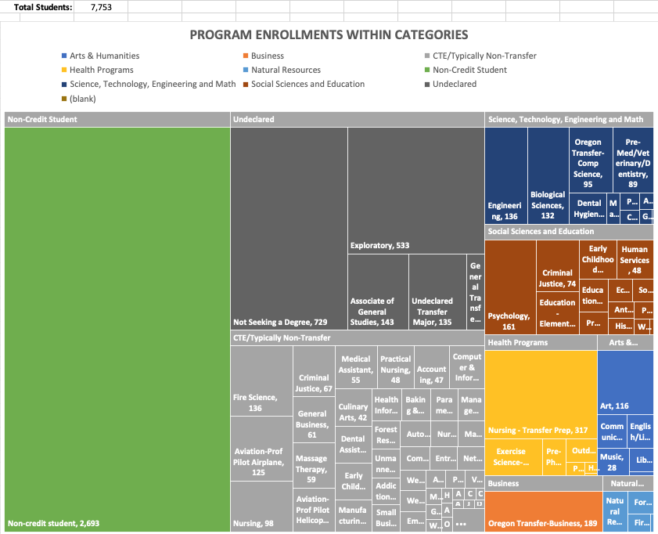
Most colleges do not actively help noncredit adult education and workforce students to bridge into credit programs.

Slide 16
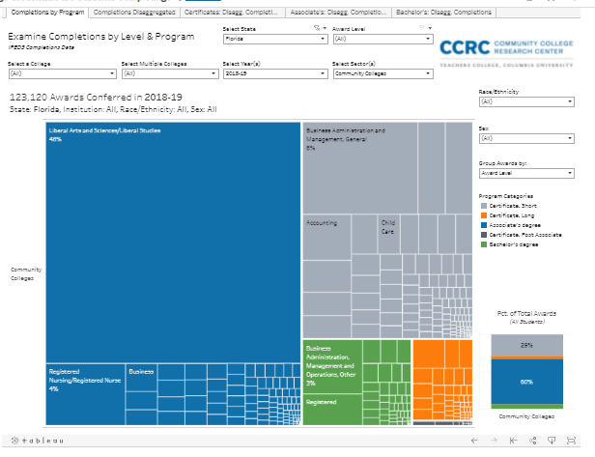
Are the programs our students completing clearly aligned with good jobs and transfer in fields of interest for students and of value for our communities?
https://public.tableau.com/app/profile/john.fink/viz/WhatCollegeCredentialsareStudentsCompleting/CompletionsbyProgram
Notes:
Is there good alignment between our short- and long-term CTE certificates and applied associate degrees? How well aligned?
How easy is it for students to stack shorter-term certificates with longer-term credentials?

Slide 17
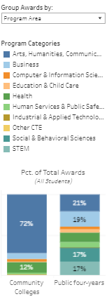
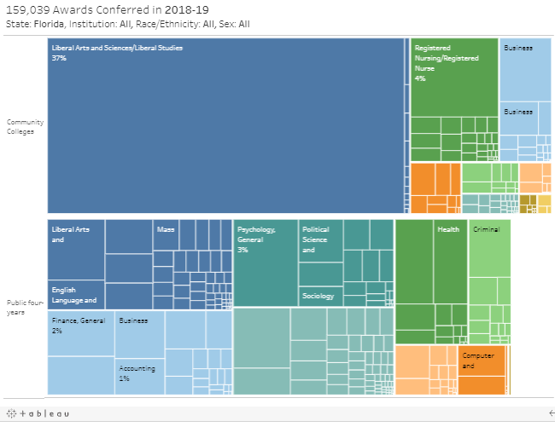
How well aligned are FCS associate degree programs with FSUS bachelor’s degree programs?
https://public.tableau.com/app/profile/john.fink/viz/WhatCollegeCredentialsareStudentsCompleting/CompletionsbyProgram
Notes:
How well aligned are our associate degree programs with the bachelor’s programs of our primary transfer destination?
Do we know whether our liberal arts associates are able to transfer and have all of their credits apply to their bachelor’s major? How do we / would we know this?

Slide 18
FCS colleges rank well nationally in outcomes, but >50% of FCS starters haven’t completed a credential after six years
40% Completed Any Degree or Credential
Below National Average
Above National Average
FL state colleges
Source: NSC Completing College Signature Report tracking the fall 2014 FTIC, degree-seeking public 2-yr entering cohort (excluding current dual enrollment students but including former DE students)

Slide 19
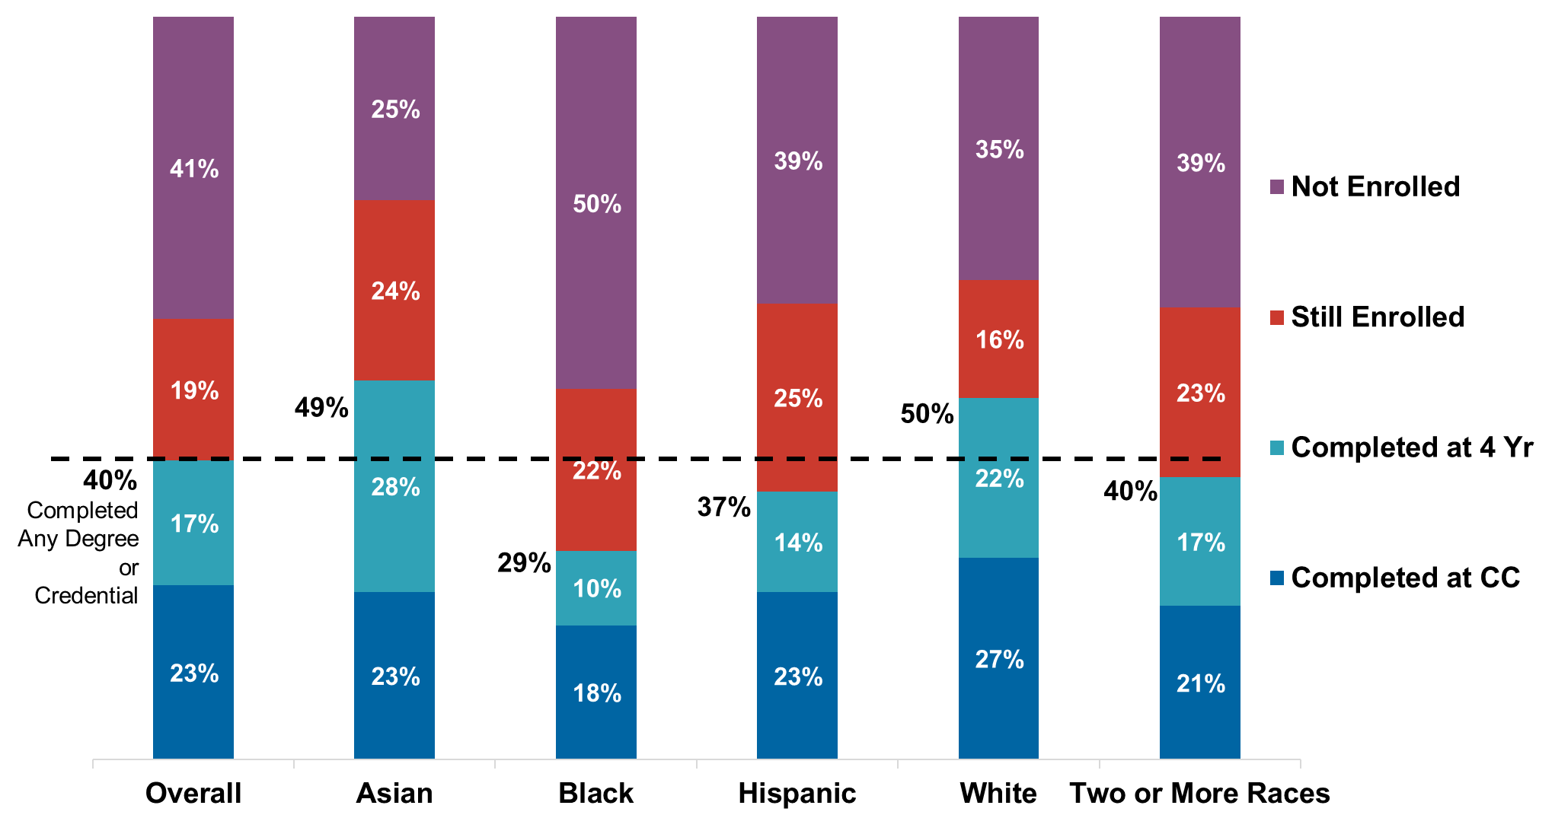
...and outcomes are especially poor for students of color (and low-income and older students)
Highest Outcomes in Six-Years: First-Time-in-College Community College Entrants
Source: NSC Completing College 2020, which tracks the fall 2014 FTIC (includes former dual enrollment degree-seeking cohorts. https://nscresearchcenter.org/wp-content/uploads/Completions_Report_2020.pdf

Slide 20
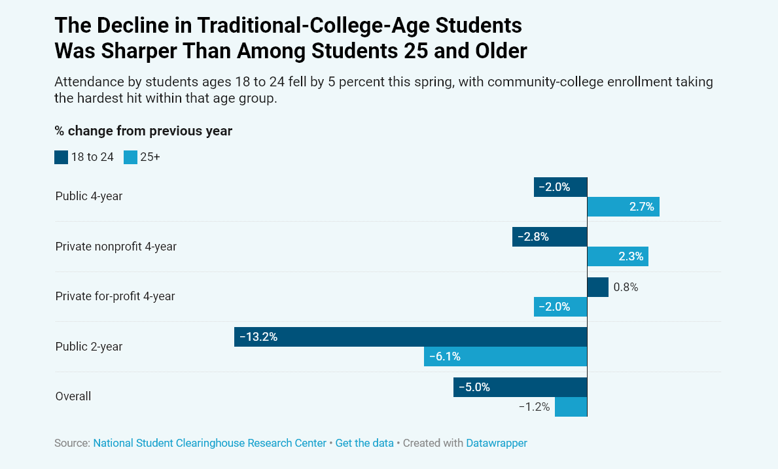
COVID has hit community colleges and their students hard...
Source: Chronicle of Higher Education, June 10, 2021, showing change in enrollment in spring 2021 compared with previous spring.

Slide 21
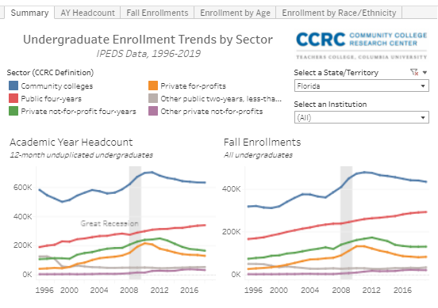
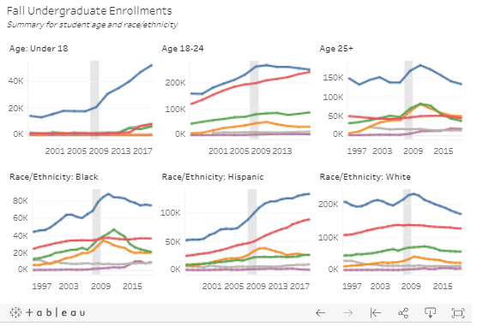
…and Florida state college enrollment has been declining for a decade, so we need to find ways to build back enrollment.
Source: https://public.tableau.com/profile/john.fink#!/vizhome/UndergraduateEnrollmentTrendsbySector/Summary

Slide 22




To achieve more equitable outcomes (and build back enrollment) community colleges need to reimagine the program onboarding experience following these research-based design principles:
ASK: Ask every student about their interests, strengths, and aspirations and help them explore relevant programs.
CONNECT: Help all students connect with faculty, students, alumni, others and coursework in a field of interest from the start.
INSPIRE: Ensure every student has light-the-fire learning experience in term 1 and active and experiential learning opportunities throughout.
PLAN: Help every student develop a full-program educational plan by the end of term 1.
Notes:
“simple things can make a big difference” Paul Jarrell

Slide 23

Take a minute to reflect
How did you choose your college major? What experiences and people were most meaningful?

Slide 24
Ask
When do we ask students about their interests, strengths, and aspirations?
What students would benefit from these conversations but aren’t currently being reached?

Slide 25
Asking students about their interests and aspirations
Intake surveys and career assessments
Additional advising and support for undecided students
Helping middle and high school students begin exploring academic and career interest and options

Slide 26
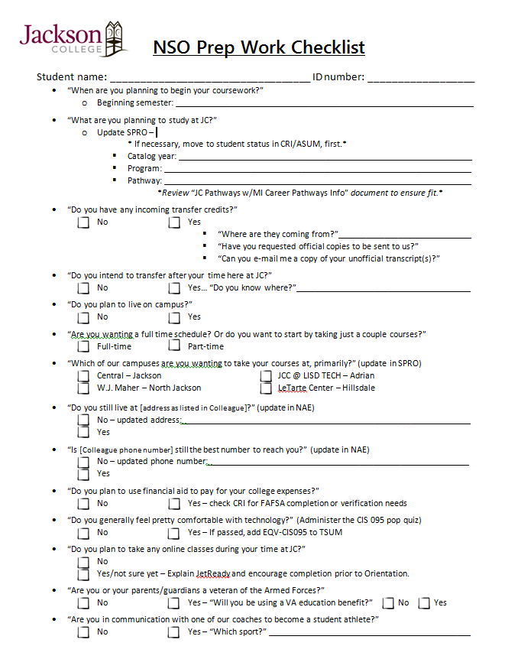
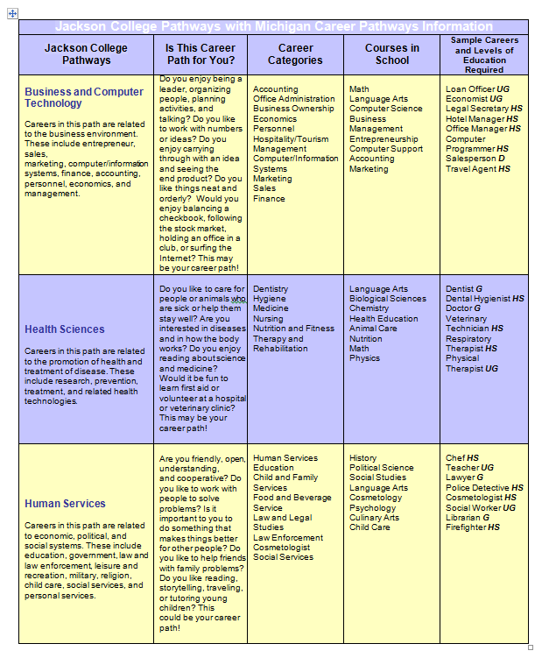
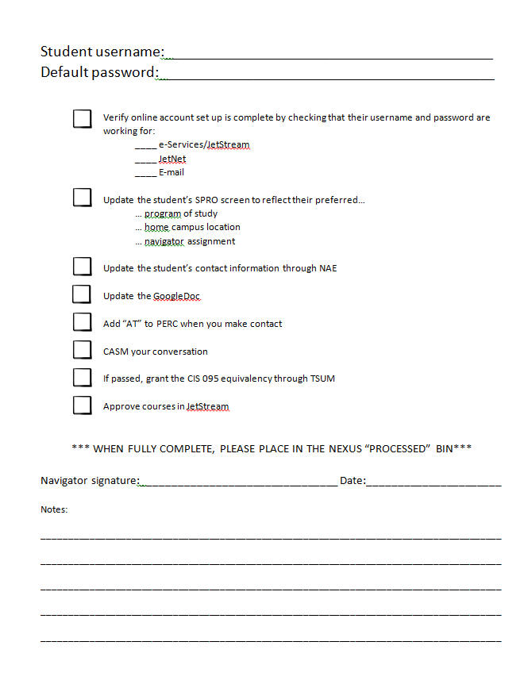
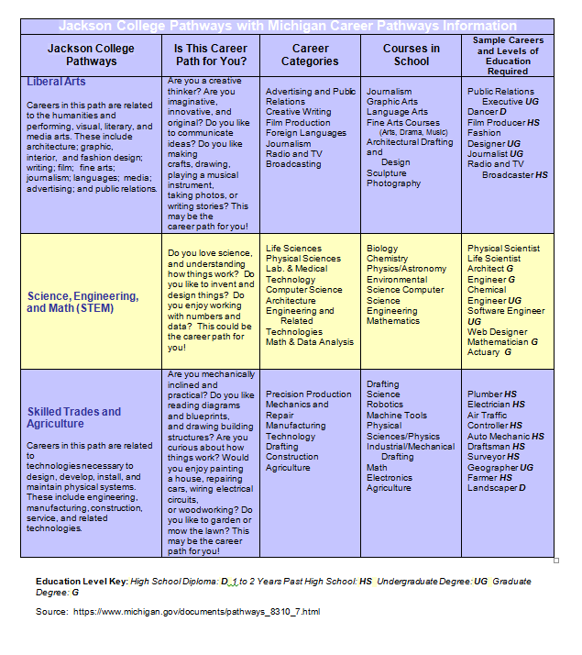

Slide 27

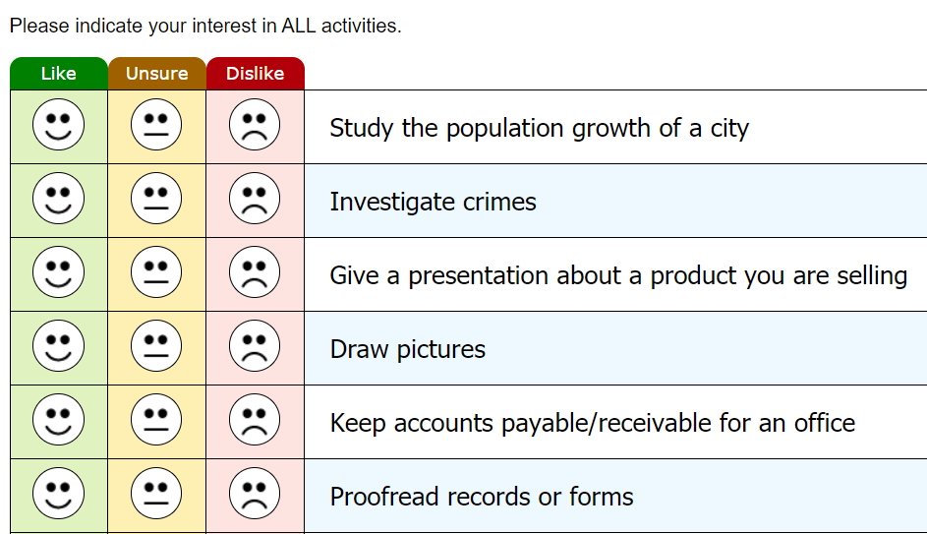
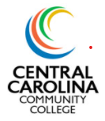
Central Carolina Community College Embark (two parts):
RIASEC-based assessment of career interests
Matching career interests to our programs
Career Decision Inventory
Questions to determine confidence in career choice

Slide 28
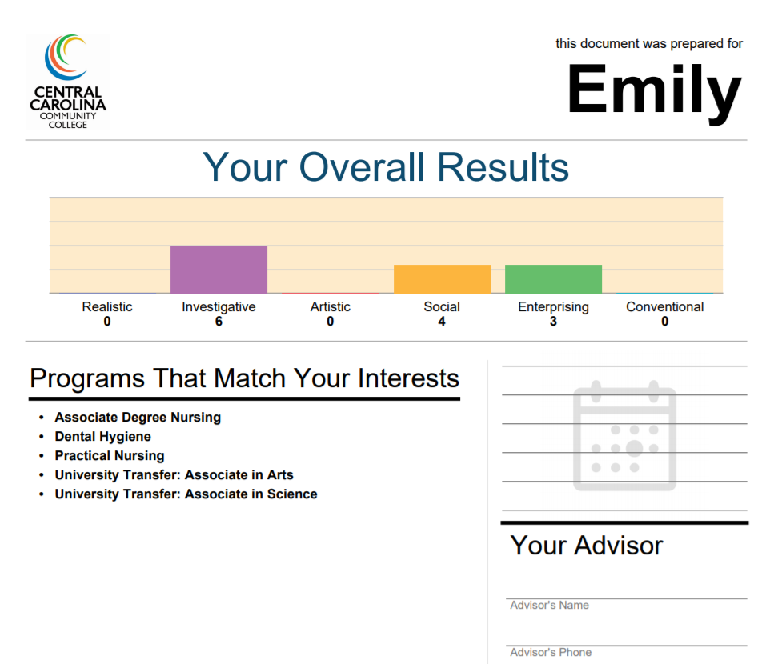

Slide 29
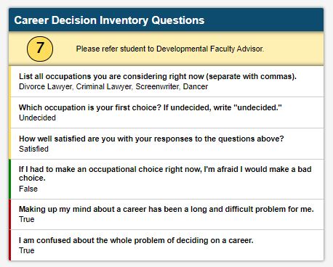
Career Decision Inventory
Used to estimate career decision readiness and career problem solving
Assesses career certainty, satisfaction and clarity
Based on the work of Leierer et. al (2017)- Career State Inventory
Score determines interventions

Slide 30
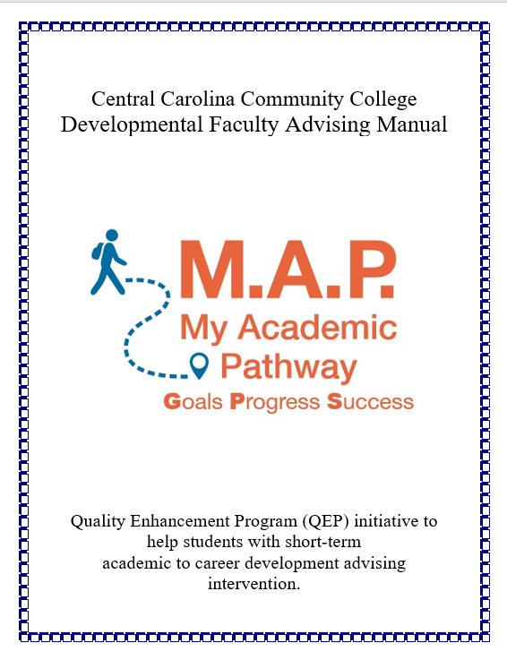
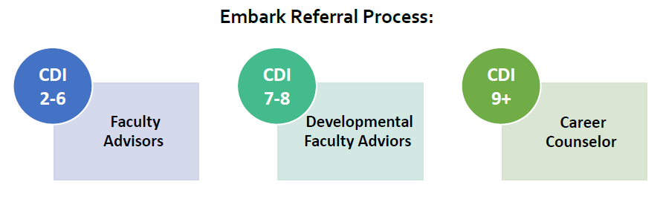
Assessment results used in conversations with students about their interests, strengths, goals
Developmental Faculty advisors - Students with an intermediate career decision (CDI) readiness
  Short-term intervention
  Training developed by career counselors
  Career advising, online inventories, hands-on career activities
  Students then referred to academic advisor or career center counselor
Career counselors see students with the highest career decision concerns

Slide 31
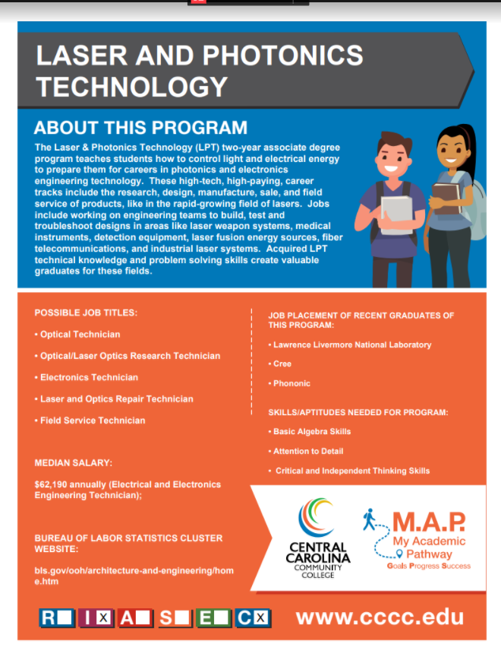
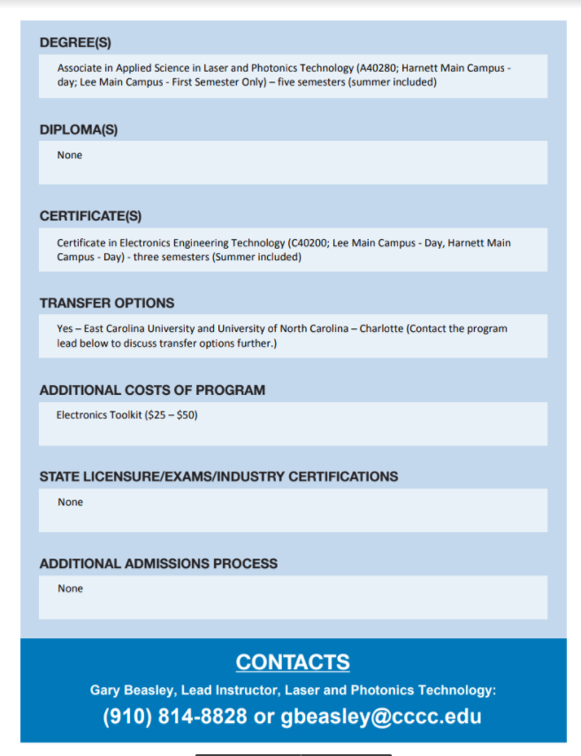
Program Information sheets
Confirming knowledge of programs

Slide 32
Is it working?
Most students (75-80%) have selected a program that corresponds to their top two RIASEC categories
About 90% of the students who have selected a program outside of their RIASEC categories switch to one which does
About 24% of students need additional career conversations based on CDI
95% of the students recommended that entering students should take the RIASEC; 98% found it easy to do
100% IPEDS graduation
+10%
150% IPEDS graduation
+19%
Program Changes
-10-16%

Slide 33
Connect
How are entering students connected with faculty and other people in their field of interest?
How is the college helping new students to develop a sense of belonging?
How can meta-majors be used to facilitate these connections?

Slide 34
Connecting students to academic and career communities
Orientation and advising based on meta-majors
Program and field showcase events by metamajor – for current and prospective students
Faculty liaisons

Slide 35
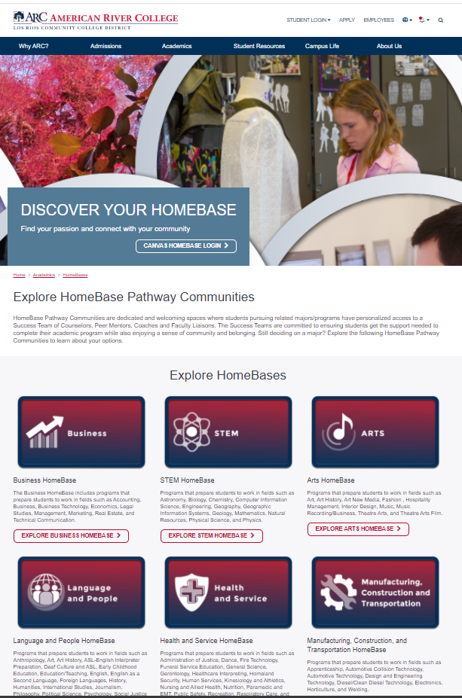
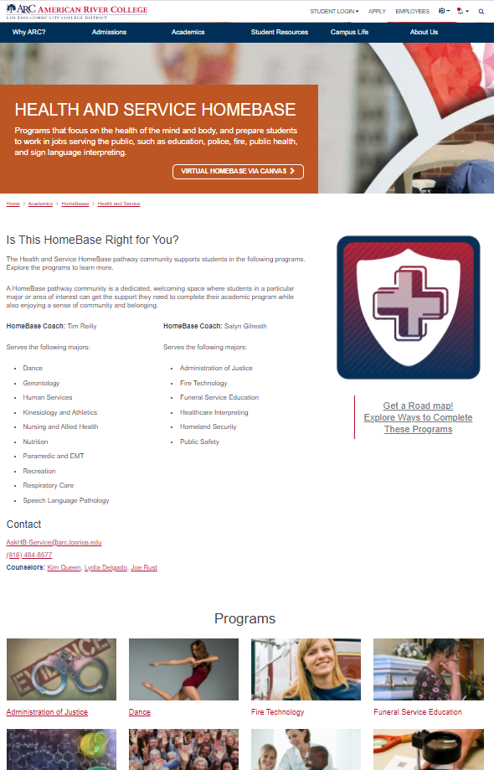
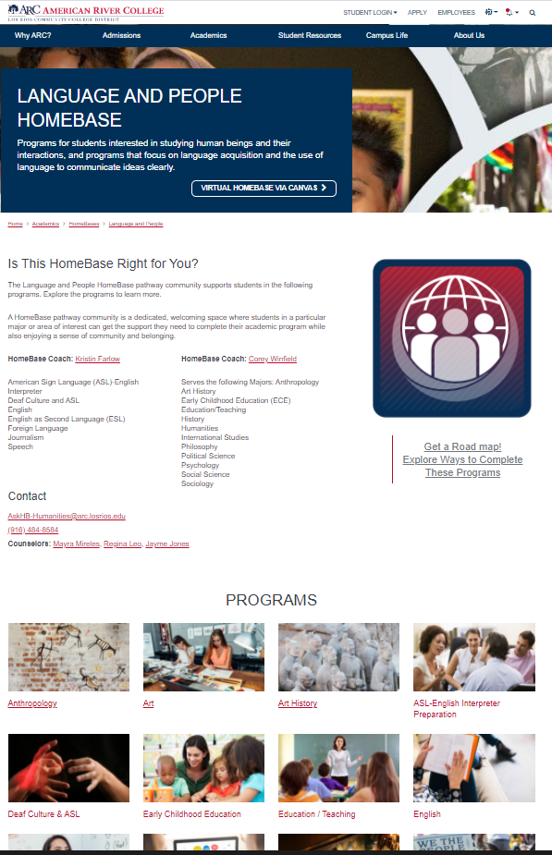
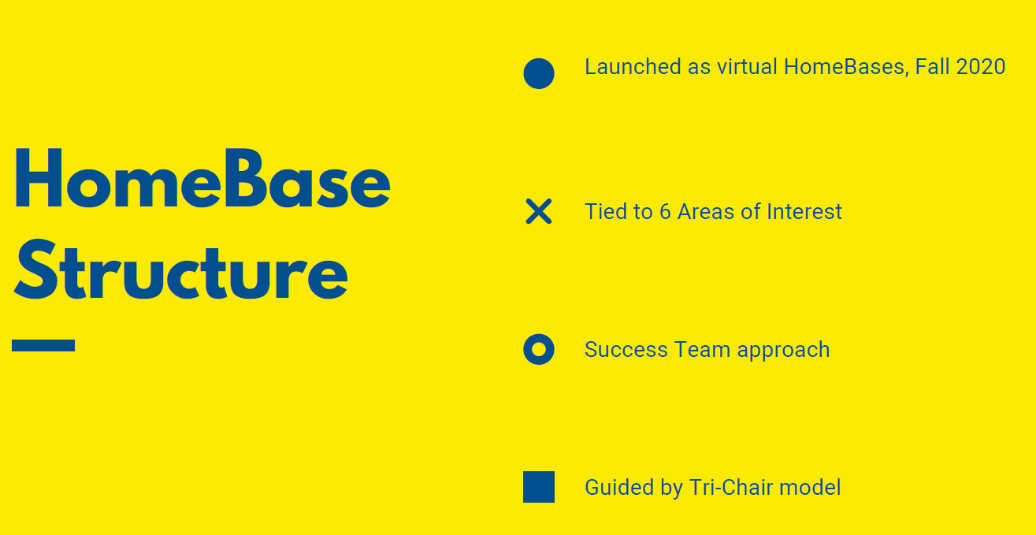
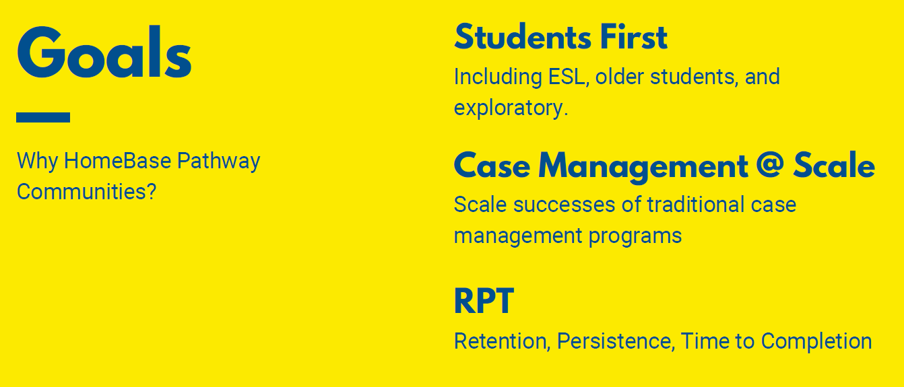
Notes:
Is this widely known throughout the college? Do faculty and staff know these numbers?
Has the college looked at these outcomes disaggregated by student race/ethnicity, age, gender, and other focus populations?

Slide 36
Inspire
How can we ensure that every student has a ‘light-the-fire’ learning experience on issues of interest in their first term?
What supports do faculty need to make this happen?

Slide 37
Inspire: Building students’ confidence as college learners
The courses students take during initial terms of enrollment:
  define the college experience
  facilitate exploration of interests
  can create confidence as learners which research indicates is key factor in college success
  demonstrate the value of investing in higher education
Notes:
Importance and opportunity for redesign of first-term/foundation program courses
We have all had that light your fire course at college
At DVC- we intentionally front load/schedule our full-time faculty in our psych 101 because we know the impact that a gateway class can have on a student’s experience

Slide 38
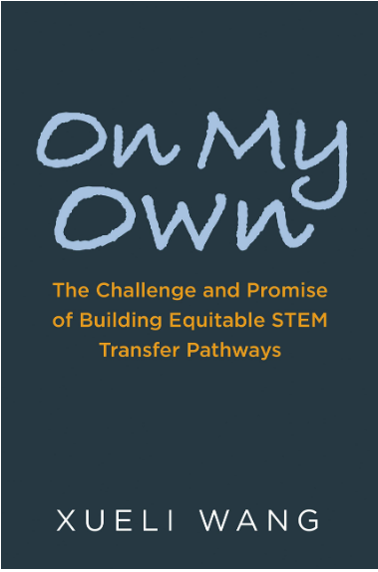
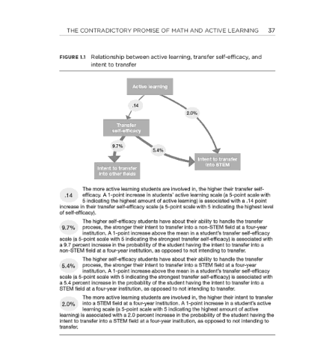
Key Finding: Active learning motivates underserved STEM-transfer intending students to persist in STEM
Source: Wang, X (2020). On My Own: The Challenges and Promise of Building Equitable STEM Transfer Pathways. Harvard Education Press.
Notes:
These courses can also provide the opportunity for faculty to “light the fire” for learning more about the field, by exposing students to foundational concepts that illuminate the core puzzles and paradoxes of disciplines, and offer new analytic lenses that students can apply to critique and question society and aspects of their personal circumstances.
They give students an opportunity to explore the foundational information in a field of study, and understand applications to careers
Different than a HS course

Slide 39

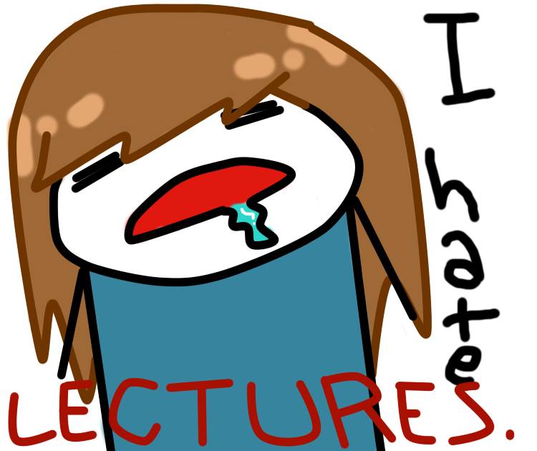
Notes:
I searched for some cartoons depicting students bored in college classes, and the internet is rife with such images. Particularly, intro program courses tend to be offered in lecture formats. So, it’s unfortunate that students being bored in college courses seems like a typical part of the college experience.
Two axis of boring-ness: The way that a course is taught is obviously a big part of what makes it engaging, but courses may also be boring for students when the content has no clear relevance to students’ interests or goals.

Slide 40

First-term courses for many students seem like high school all over again
Many students self-advise
Advisors recommend “safe” general education courses
Students are unable to access program level courses because of developmental education (including co-req courses)
Notes:
Students who self advise don’t know which courses to choose, and may select courses that waste time and money without helping to clarify interests
Advisors may recommend that (particularly) undecided students take safe gen ed courses that do not provide engaging learning experiences, this harkens back to a model where we expect students to clarify their goals and interest on their own, often by turning them lose in Liberal Arts programs with little guidance to choose courses
Many students cannot access program level courses because of dev ed placement, this likely disproportionately affects first gen in college, low-income students and students of color

Slide 41
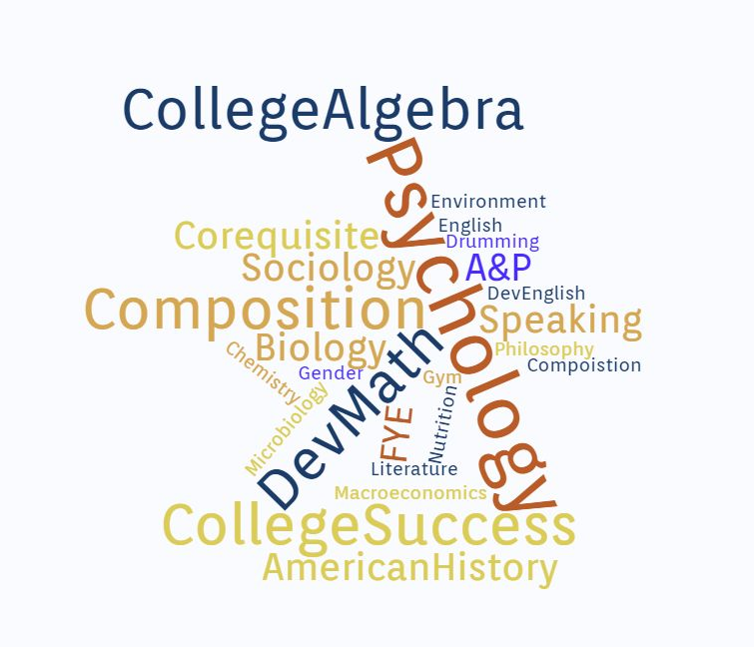
What courses are new students taking in their first term of enrollment?
Notes:
As you review your course taking data, think about whether the courses that students are taking in the first term are helping them explore, and engaging them in higher education. First term courses present an opportunity to sell students on a program. Given what you know about the courses that students are taking is it likely that it happening? If you don’t know, how could you find out?
Any course can be an exciting light the fire course depending on how it's taught, and any intro course could be contextualized to present relevant info and experiences to students, if it’s designed that way.

Slide 42
Are students taking courses in their first terms that “light the fire” for learning?
Dual Enrollment
(N = 605 students)
#1 Program
Liberal Arts and Sciences – Associate in Arts (N = 1300 students)
Rank | Course Title | Course ID | # of program students who took the course | % of program students who took the course
1 | INTRODUCTION TO PSYCHOLOGY | 2012 | 254 | 19%
2 | FRESHMAN ENGLISH I | 1101 | 250 | 19%
3 | HUMAN ANATOMY/PHYSIOLOGY I | 1085C | 248 | 19%
4 | FIRST-YEAR EXPERIENCE SEMINAR | 1106 | 241 | 18%
5 | INTRO TO MICROCOMP/WINDOWS | 1100C | 180 | 14%
6 | FUND OF SPEECH COMMUNICATION | 2608 | 164 | 13%
7 | INTERMEDIATE ALGEBRA | 1033 | 146 | 11%
8 | AMERICAN GOVERNMENT | 1041 | 128 | 10%
9 | COLLEGE ALGEBRA | 1105 | 126 | 10%
10 | GENERAL SOCIOLOGY | 2000 | 90 | 7%
>10 | 2 other different courses attempted by at least 1 student from this program
Rank | Course Title | Course ID | # of program students who took the course | % of program students who took the course
1 | FRESHMAN ENGLISH I | 1101 | 223 | 37%
2 | COLLEGE ALGEBRA | 1105 | 186 | 31%
3 | INTRO TO MICROCOMP/WINDOWS | 1100C | 117 | 19%
4 | FUND OF SPEECH COMMUNICATION | 2608 | 111 | 18%
5 | INTRODUCTION TO PSYCHOLOGY | 2012 | 87 | 14%
6 | AMERICAN GOVERNMENT | 1041 | 68 | 11%
7 | SURVEY OF ECONOMICS | 1000 | 60 | 10%
8 | FRESHMAN ENGLISH II | 1102 | 42 | 7%
9 | INTRODUCTORY SURVEY TO 1877 | 1010 | 40 | 7%
10 | PRECALCULUS ALGEBRA | 1140 | 38 | 6%
>10 | 2 other different courses attempted by at least 1 student from this program
Notes:
What support are we providing to instructors in these program foundation courses to make sure they are really lighting the fire for learning, and formally and informally introducing students to the field?
How would this top list of courses for the AA students compare to the courses new students would take at our top transfer partner universities?

Slide 43

“Light the Fire” Courses
Present an opportunity to motivate students by exposing them to issues/fields of interest to them
Expose students to foundational concepts, theories, and information about a discipline, and applications to careers
Incorporate active learning opportunities to give students engaging, hands-on learning experiences
Notes:
These courses can also provide the opportunity for faculty to “light the fire” for learning more about the field, by exposing students to foundational concepts that illuminate the core puzzles and paradoxes of disciplines, and offer new analytic lenses that students can apply to critique and question society and aspects of their personal circumstances.
They give students an opportunity to explore the foundational information in a field of study, and understand applications to careers
Different than a HS course

Slide 44
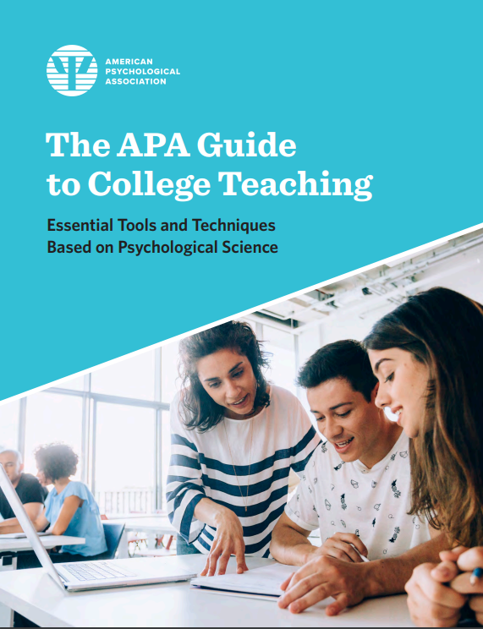
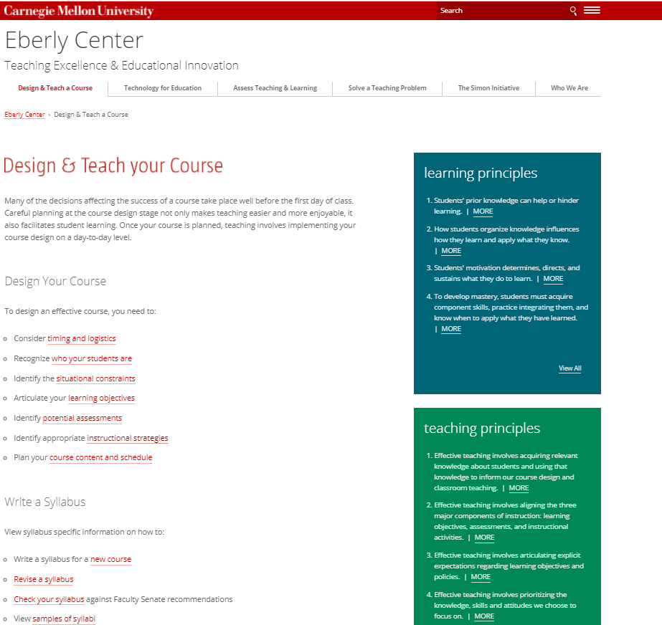
Growing body of research offering practical guidance on how to teach undergraduates effectively and equitably

Slide 45
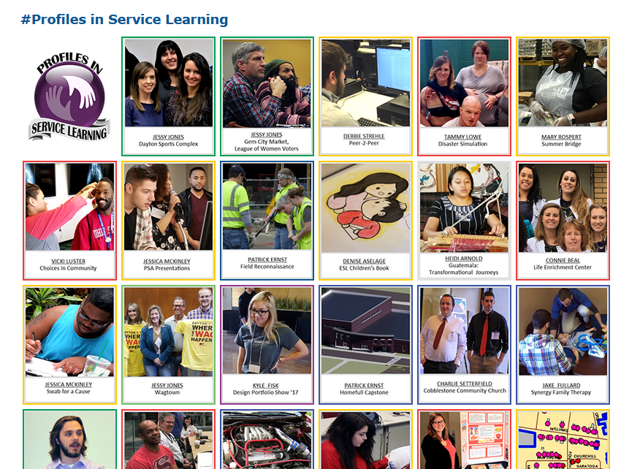
Career community-specific service earning at Sinclair Community College
https://ctl.sinclair.edu/teaching-and-learning/student-engagement/service-learning/

Slide 46
Ways to Engage Faculty to Ensure Learning
Form faculty inquiry and action teams by meta-major to identify “light the fire” program foundation courses and support faculty who teach them
Develop communities of practice (active/experiential learning, equitable syllabi; equitable grading and assessment; STEM, English, math)
Notes:
This work cant be discrete- like a brown bag… must be systematic and continuous

Slide 47
Plan
How can we help every student develop a full-program educational plan by the end of their first term?
How can advising appointments and first-year experience courses be restructured to include educational planning?
What processes do we need to develop to ensure advisors are working with students to modify their plans as needed?

Slide 48



Planning a path to help students achieve their goals
Most GP colleges help students develop a plan through advising and required first-year experience courses
Elements of a good education plan:
Covers the entire program and is based on a program map
Customized to account for prior credits, educational goals and personal interests (electives), transfer destination and major, timeline to completion
Easily accessible to students, advisors, and faculty
Regularly updated to reflect changes
Tied to scheduling and registration processes
Notes:
Required education planning as part of advising and first-year experience courses.
· Columbus State, Cuyahoga, Lakeland Community College, Lorain County, and North Central State College all include creating an education plan as a required assignment in their first-year experience courses. At Lakeland, Lorain County and North Central State, education planning begins with students’ first advising meeting. At Lakeland, students meet with an academic counselor (advisor) during orientation to begin making an education plan. They continue working on the plan during the first-year experience course and meet again with an academic counselor to finalize it. At Lorain County, students create an initial plan during their first meeting with an advisor, explore either their chosen or exploratory academic program through a reflective process in the first-year experience course, and then finalize their graduation plan during the course. At North Central State, students initially create a two-semester plan with assistance from a Success Coach responsible for new student advising. They then complete the plan in a first-year experience course with the assistance of an Academic Liaison (division advisor). Both Success Coaches and Academic Liaisons are associated with one of the three main academic areas of the college (Health Sciences; Business, Industry, and Technology; and Liberal Arts and Public Service).
At Columbus State and Cuyahoga, students are introduced to education plans during the first-year experience course and then work with an advisor to complete the plan as an assignment for the course. At Columbus State, students are required to meet with an advisor as part of the process of creating an education plan for the first-year experience course. And at Cuyahoga, advisors reinforce the first-year course assignment to create an education plan by reviewing it with students during mandatory first semester advising appointments.
Laramie County: The college’s first-year experience course is focused on career exploration and educational planning. Students develop full-program educational plans using a planning tool implemented in fall 2019.

Slide 49
What FSC students say they want during onboarding
Assistance exploring academic and career interests
Information on program options in fields of interest and their connection to career and baccalaureate transfer opportunities
Opportunities to interact with other new and current students, faculty, and others who share similar academic and career interests
Chance to take a course on topics of interest in term 1
Help developing a full-program academic and financial plan
Source: Kopko and Griffin (2020). https://ccrc.tc.columbia.edu/publications/redesigning-community-college-onboarding-guided-pathways.html

Slide 50
Ensuring program onboarding advances equity
To achieve equity in outcomes for marginalized and underserved students, it is critical to tailor onboarding support to meet the needs of different student groups, for example:
Students from races/ ethnic groups historically excluded from higher education, English learners
Military students
International students
Students with disabilities
Undecided students
Adult students
Recent high school graduates
Dual enrollment students
Students enrolled in basic skills programs
Additional target populations at our college
Notes:
MAIN POINT: Underserved students do not have high quality onboarding experiences -- most often, privileged students are the ones that get access to people who place interest in their interests. Placing equity in the center means all students should get ACIP - offering all students a rich onboarding experience.

Slide 51

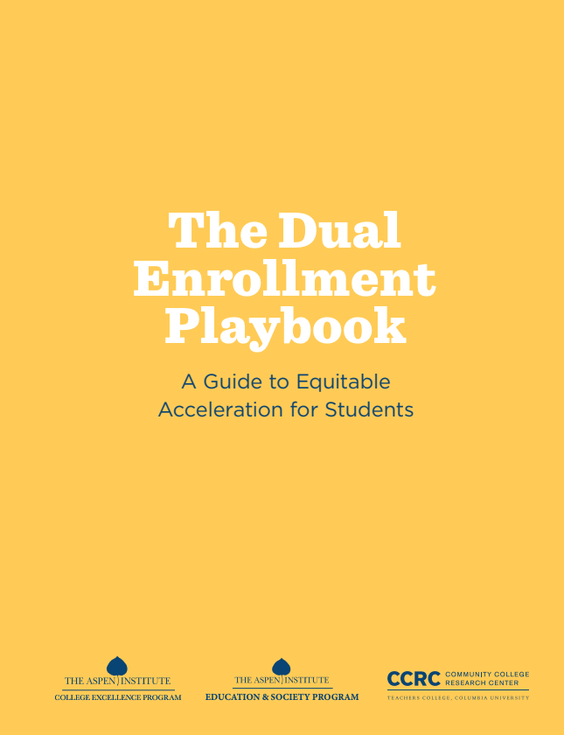
What can be learned from high schools and colleges that are more effective in serving students of color through dual enrollment?

Slide 52
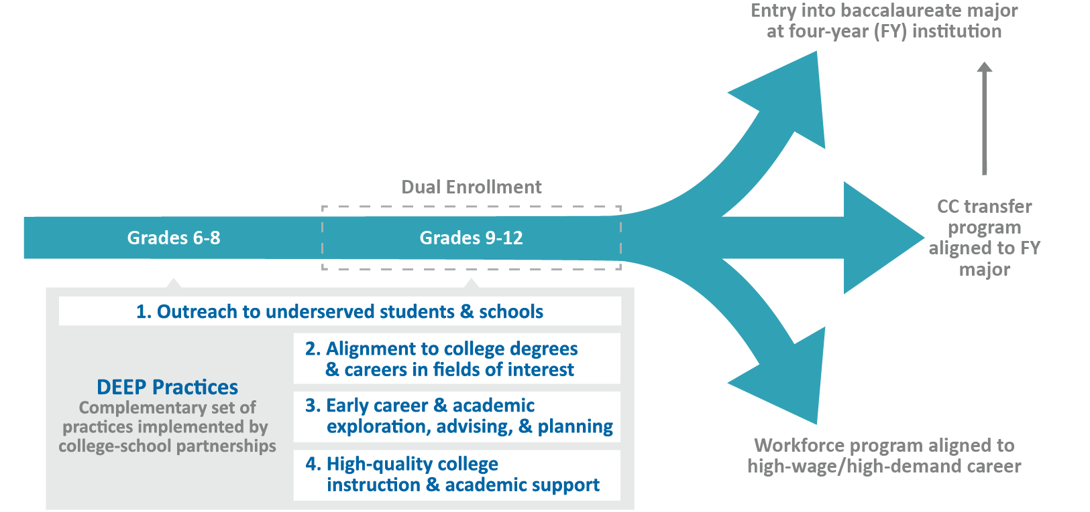
Dual Enrollment Equity Pathways (DEEP)

Slide 53
Activity: Map the Current Program Onboarding Experience at Your College
What is the current program onboarding experience for students under each of the design principles in the Ask–Connect–Inspire–Plan framework?
 | Ask every student about their interests, strengths, and aspirations | Connect them with faculty, students, alumni, and others with similar interests | Inspire learning in term 1 through “light-the-fire” college-level courses on issues of interest | Help every student develop an individualized education plan aligned to jobs/ transfer in their field of interest by the end of term
What do most students experience? (Where, when, with whom, how consistently?)
Notes:
Next, spend the remaining time reviewing and updating Activity A in the Mapping the Student Experience document, which you began during your async time this week. Revise in light of this ACIP discussion. After that we will all come back together in the main room to

Slide 54
Activity: Reimagine Program Onboarding Experiences for Students
How would you reimagine program onboarding to serve all students more equitably?
Practice Area | Wildly brainstorm universal and tailored program onboarding experiences
Ask every student about their interests, strengths, and aspirations | Whole-college: Tailored for specific student groups:
Connect them with faculty, students, alumni, and others with similar interests | Whole-college: Tailored for specific student groups:
Inspire learning in term 1 through “light-the-fire” college-level courses on issues of interest | Whole-college: Tailored for specific student groups:
Help every student develop an individualized education plan aligned to jobs/transfer in their field of interest by the end of term 1 | Whole-college: Tailored for specific student groups:

Slide 55
Guiding questions for colleges seeking to reimagine the program onboarding experience:
How can we help every student make a purposeful program choice and plan?
What activities and experiences will help students build connections with people in fields of interest to them?
How can we ensure that every student takes an inspiring college-level course in their first term?
How can we personalize Ask-Connect-Inspire-Plan supports for underserved student groups?

Slide 56

Thanks!
Davis Jenkins, pdj2102@tc.columbia.edu

